Slide 1
Identifying Customer Needs
Teaching materials to accompany:
Product Design and Development
Chapter 5
Karl T. Ulrich and Steven D. Eppinger
5th Edition, Irwin McGraw-Hill, 2012.

Slide 2

Product Design and Development
Karl T. Ulrich and Steven D. Eppinger
5th edition, Irwin McGraw-Hill, 2012.
Chapter Table of Contents:
Introduction
Development Processes and Organizations
Opportunity Identification
Product Planning
Identifying Customer Needs
Product Specifications
Concept Generation
Concept Selection
Concept Testing
Product Architecture
Industrial Design
Design for Environment
Design for Manufacturing
Prototyping
Robust Design
Patents and Intellectual Property
Product Development Economics
Managing Projects

Slide 3
Product Development Process
Planning
Concept
Development
System-Level
Design
Detail
Design
Testing and
Refinement
Production
Ramp-Up

Slide 4
Concept Development Process
Mission
Statement
Identify
Customer
Needs
Establish
Target
Specifications
Generate
Product
Concepts
Select
Product
Concept(s)
Test
Product
Concept(s)
Set
Final
Specifications
Plan
Downstream
Development
Development
Plan
Perform Economic Analysis
Benchmark Competitive Products
Build and Test Models and Prototypes

Slide 5
Outline
Nature of needs
Need identification process
An exercise

Slide 6
Nature of needs
Needs in the “use” environment
Products have to serve a real need and affordable to the customer
Focus on user’s needs, instead of “wants”

Slide 7
Customer Needs Process
Define the Scope
  Mission Statement
Gather Raw Data
  Interviews
  Focus Groups
  Observation
Interpret Raw Data
  Need Statements
Organize the Needs
  Hierarchy
Establish Importance
  Surveys
  Quantified Needs
Reflect on the Process
  Continuous Improvement

Slide 8
1: Define the scope of the effort
Use the project’s mission statement
  Brief (one sentence) description of the product
  Key business goals
  Target market(s) for the product
  Secondary market
  Assumptions that constrain the development effort (boundary, scope, limit)
  Stakeholders (end users, retailers, sales, service centers, production, legal, etc.)

Slide 9
Mission Statement
Example: Screwdriver Project
Product Description
  A hand-held, power-assisted device for installing threaded fasteners
Key Business Goals
  Product introduced in 4th Q of 2000
  50% gross margin
  10% share of cordless screwdriver market by 2004
Primary Market
  Do-it-yourself consumer
Secondary Markets
  Casual consumer
  Light-duty professional
Assumptions
  Hand-held
  Power assisted
  Nickel-metal-hydride rechargeable battery technology
Stakeholders
  User
  Retailer
  Sales force
  Service center
  Production
  Legal department

Slide 10
2-1: Gather raw data from customers (methods)
Methods
  One-on-one interviews
  Focus groups (selected customers in a discussion with a moderator
    Better than one-on-one as shown in Fig 4.4 on page 57
  Observing the product in use
  Survey
Customer selection matrix
  Applications (industrial, household, personal) vs. customer types (user, lead user, retailer, service center, etc.)

Slide 11
How Many Customers?
100
80
60
Percent of Needs Identified
One-on-One Interviews (1 hour)
Focus Groups (2 hours)
40
20
0
0
1
2
3
4
5
6
7
8
9
10
Number of Respondents or Groups
From: Griffin, Abbie and John R. Hauser. “The Voice of the Customer”, Marketing Science. vol. 12, no. 1, Winter 1993.

Slide 12
2-2: Art of eliciting need data from customer
Go with the flow
Use existing and competitor’s products, or other stimuli
Suppress pre-conceived hypotheses about the product technology
Have the customer demonstrate the product and/or typical tasks related to the product
Be alert for surprises and the expression of latent (non-articulated) needs
Watch for nonverbal information (comfort, image, or style)

Slide 13
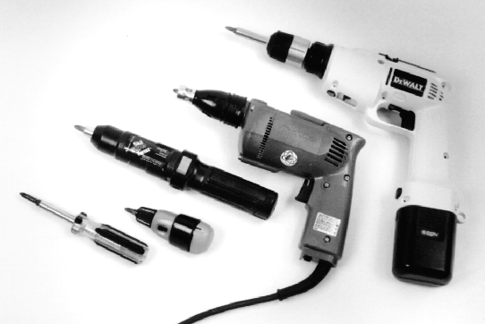
Customer Needs Example:
Cordless Screwdrivers

Slide 14

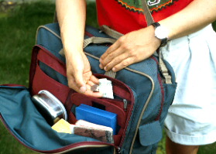
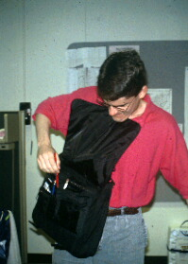
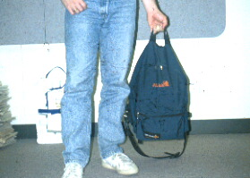
Visual Information Example: Book Bag Design

Slide 15
2-3: Documenting interactions with customer
Customer statements, accompanied with the documentation methods
  Audio recording
  Notes
  Video recording
  Still photography

Slide 16
3: Interpret raw data in terms of customer needs
Guidelines
  Express the need in terms of what the product has to do, not in terms of how it might do it.
  Express the need as specifically as the raw data
  Use positive, not negative, phrasing.
  Express the need as an attribute of the product
  Avoid the words must and should.

Slide 17
Five Guidelines for Writing Needs Statements
Guideline
Customer Statement
Need Statement-Wrong
Need Statement-Right
What Not How
“Why don’t you put protective shields around the battery contacts?”
The screwdriver battery contacts are covered by a plastic sliding door.
The screwdriver battery is protected from accidental shorting.
Specificity
“I drop my screwdriver all the time.”
The screwdriver is rugged.
The screwdriver operates normally after repeated dropping.
Positive Not Negative
“It doesn’t matter if it’s raining, I still need to work outside on Saturdays.”
The screwdriver is not disabled by the rain.
The screwdriver operates normally in the rain.
Attribute of the Product
“I’d like to charge my battery from my cigarette lighter.”
An automobile cigarette lighter adapter can charge the screwdriver battery.
The screwdriver battery can be charged from an automobile cigarette lighter.
Avoid “Must” and “Should
“I hate it when I don’t know how much juice is left in the batteries of my cordless tools.”
The screwdriver should provide an indication of the energy level of the battery.
The screwdriver provides an indication of the energy level of the battery.

Slide 18
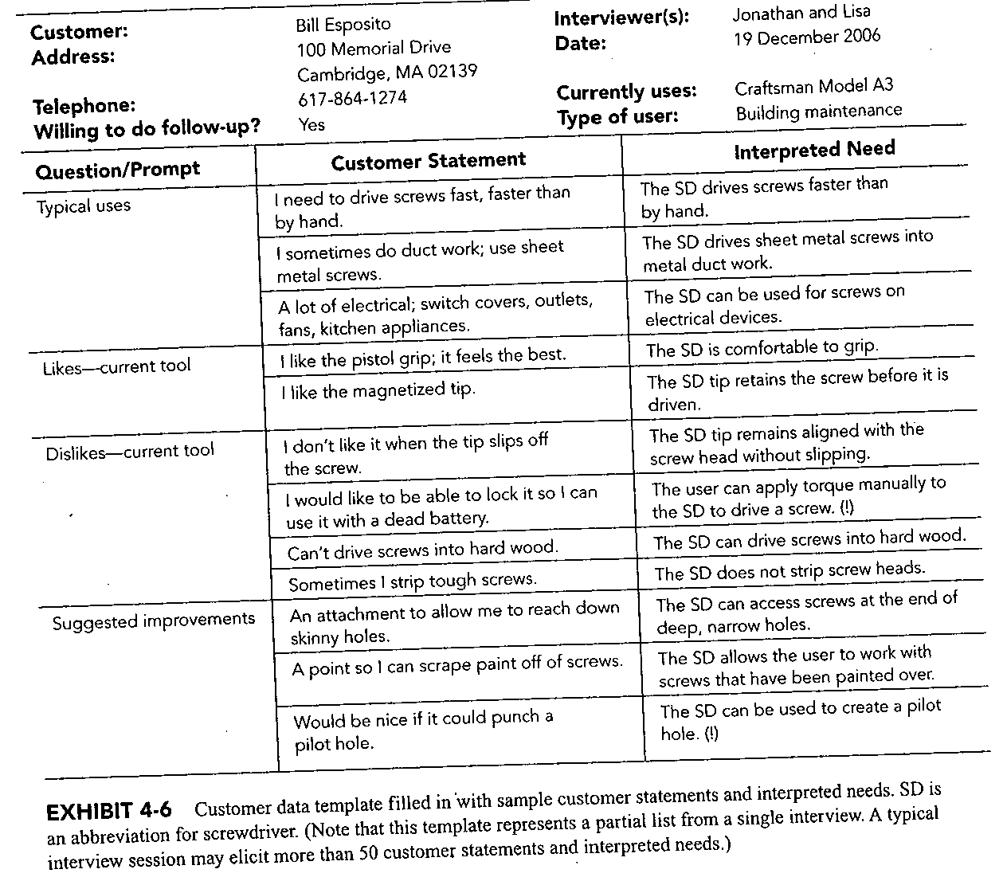

Slide 19
4: Organize the needs into a hierarchy
Print each need statement on a separate card or a self stick note
Eliminate redundant statement
Group the cards according to the similarity of the needs they express
Choose a label for each group
Consider creating super-groups consisting of two to five groups.
Review and edit the organized need statements

Slide 20
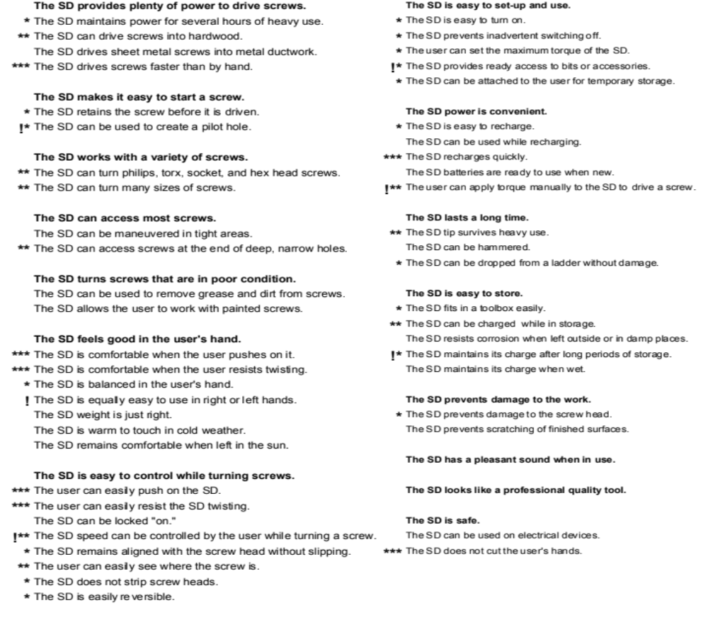
Organized List of Customer Needs

Slide 21
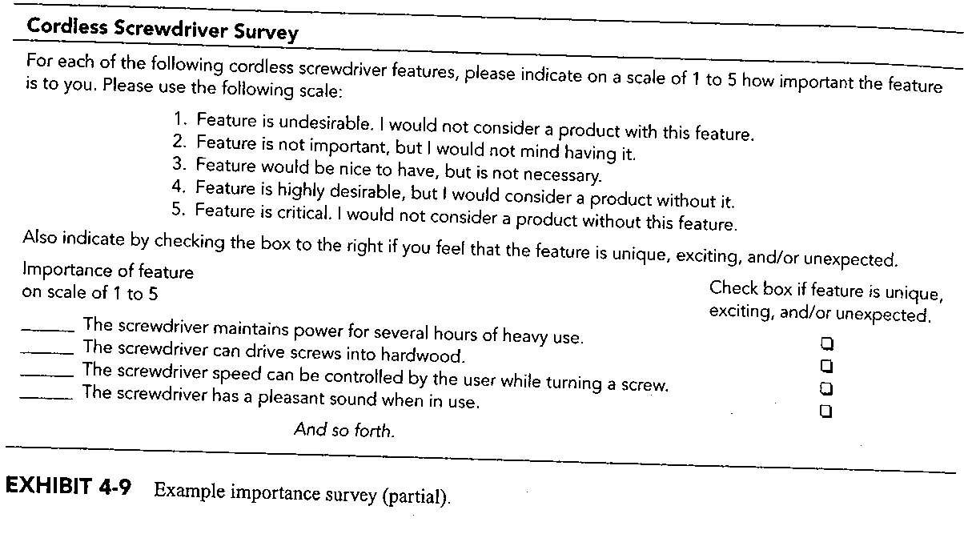
A Survey Design for Ranking Customer Needs

Slide 22
5: Establish the relative importance of the needs
Use the customers (to rank importance as well as criticality)
See a survey in Fig 4.9 on page 67

Slide 23
6: Review the Result and Reflect on the Process
Whether the product is focused on needs of customers
Whether all critical needs are addressed
Whether we sent out “thank you” notes to customers.
Whether there are rooms to improve the process for future efforts.
Whether the entire team understands the needs

Slide 24
Caveats
Capture “What, Not How”.
Meet customers in the use environment.
Collect visual, verbal, and textual data.
Props will stimulate customer responses.
Interviews are more efficient than focus groups.
Interview all stakeholders and lead users.
Develop an organized list of need statements.
Look for latent needs.
Survey to quantify tradeoffs.
Make a video to communicate results.

Slide 25
Class Example: Identify customer needs through discussion of a selected group
Method: discussion of a group of lead customers
Product: powered screwdriver (& book bag)
Rules:
  No one criticizes anyone.
  Willing to compromise and reach a consensus.
  Identify customer needs or wants. It does not matter whether they are a "must" or "should.
  It is not yet a product specification. Therefore qualitative statement is fine.

Slide 26
Class exercise: Identify customer needs through discussion with a selected group
Four-step procedure:
  Individual writes down five need statements (expectations) for the product (powered hand-held screwdriver and then book bag)
  Consolidate the need statements.
  Classify need statements into groups and super-groups in a hierarchical fashion.
  Rank each need in terms of its relative importance and criticality (e.g., Each one picks 5 needs and add them up

Slide 27
Customer Needs
Example:Cordless Screwdrivers

Slide 28
1: Write down need statements
Group the lead users into groups of 4
Each group come up with 5 need statements

Slide 29
2: Consolidate the needs
Detachable tips
Sufficient accessory tips
Adjustable speed
Adjustable torque
Minimum vibration
Light weight
Easy to use
Easy to carry
Cordless
Long-lasting rechargeable battery
Weather proof
Reversible
Heavy duty casing
Reasonable price
Quick to re-charge
Re-chargeable from car cigarette lighters

Slide 30
3: Classify/group the needs
Price
Weight
Function
Operations
Power source
Maintenance

Slide 31
4: Rank Customer Needs
Each user picks five needs
  by their importance
Each user picks five needs
  by their criticality.

Slide 32

Class Exercise: Book Bag Design

Slide 33
Chapter 4 HW
Exercise 1, on page 90
Due next week

Slide 34
Needs Translation Exercise:
Book Bag Design Example
“See how the leather on the bottom of the bag is all scratched; it’s ugly.”
“When I’m standing in line at the cashier trying to find my checkbook while balancing my bag on my knee, I feel like a stork.”
“This bag is my life; if I lose it I’m in big trouble.”
“There’s nothing worse than a banana that’s been squished by the edge of a textbook.”
“I never use both straps on my knapsack; I just sling it over one shoulder.”

